Slide 1

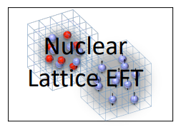

Carbon and Oxygen isotope chains
(And others)
Young-Ho Song (Institute for Rare Isotope Science, IBS)
With NLEFT collaboration
Bethe Forum: Frontiers in Nuclear Physics
2023.Nov.21-23, BCTP, Bonn
https://indico.hiskp.uni-bonn.de/event/389/

Slide 2
Nuclear Lattice Effective Field Theory Collaboration
Serdar Elhatisari(Gaziantep Islam Science and Technology)
Lukas Bovermann(Ruhr)
Evgeny Epelbaum (Bochum)
Dillon Frame (Juelich)
Fabian Hildenbrand(Darmstadt)
Hermann Krebs(Ruhr)
Timo A. Lähde (Juelich)
Dean Lee (MSU)
Ning Li(Sun Yat-sen)
Bing-Nan Lu( Graduate School of China Academy of Engineering Physic)
Myungkuk Kim(CENS,IBS)
Youngman Kim (CENS,IBS)
Young-Ho Song(IRIS,IBS)
Yuanzhuo Ma(Peking)
Ulf-G. Meißner (Bonn/Juelich)
Gautam Rupak(Mississippi State)
Shihang Shen (Juelich)
Gianluca Stellin( CEA Paris-Saclay)
And More…

Slide 3
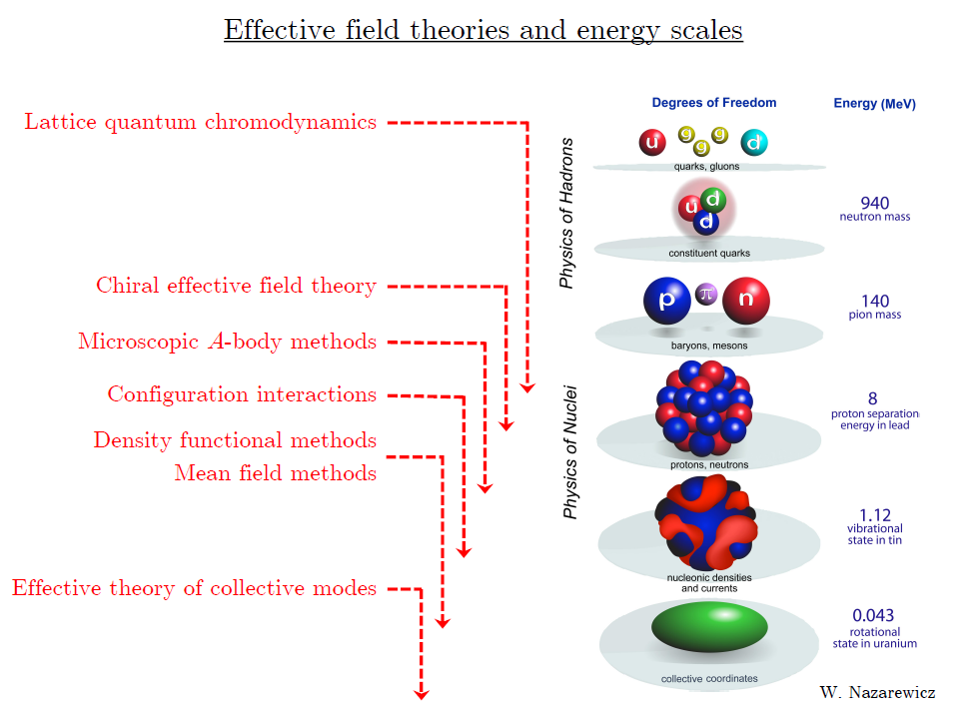
Ab initio
Nuclear
Theory

Slide 4
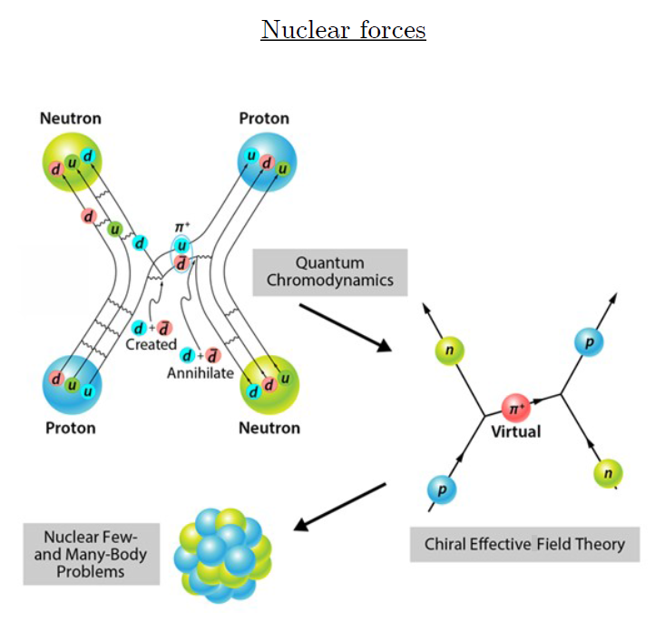
Ab-initio method
ab-initio Nuclear Physics
(1) nucleon degrees of freedom
(2) nucleon-nucleon interaction
Goal: predict wide range(structure, reaction, nuclear matter) of nuclear phenomena (without parameter fitting, model assumption) from nuclear interaction (for 2-body,3-body, many-body, based on QCD)
Direct connection between
Nuclear Force ↔ Nuclear Phenomena

Slide 5
Ab initio many-body
(ab initio) Nuclear physics is challenging.
Non-perturbative many body problem
Ab-initio nuclear many body methods
Greens function Monte Carlo(GFMC)
No-core shell model(NCSM)
Coupled Cluster (CC)
IM-SRG, VS-SRG
Nuclear Lattice Effective Field Theory(NLEFT)
And more
With recent progress in ab-initio methods
Binding energies for wide range of nuclei
Some reaction calculation for light nuclei.

Slide 6
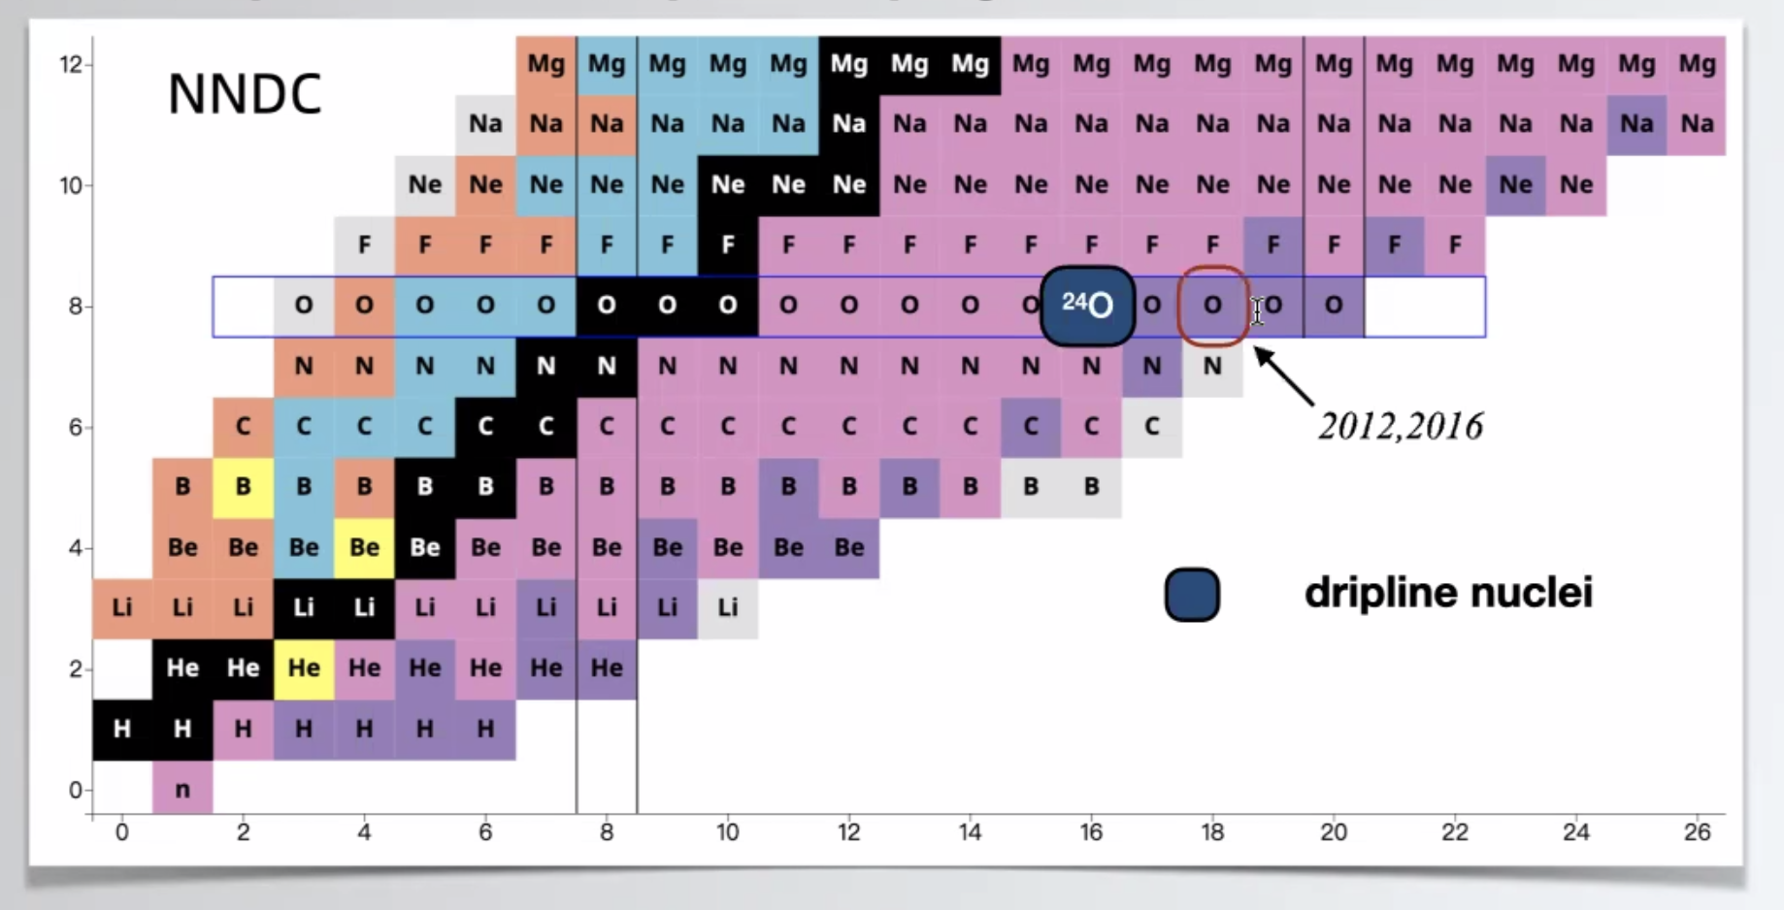
Dripline
Can we explain the dripline of Carbon, Oxygen isotopes in NLEFT?
Sensitive to nuclear force ? (Role of 3-body force?)

Slide 7
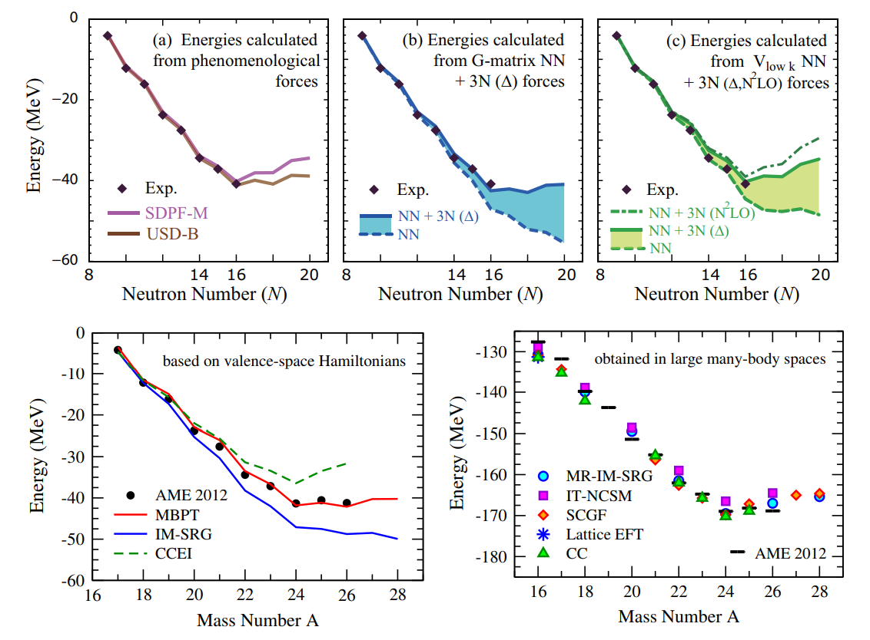
Oxygen isotopes
Ann.Rev.Nucl.Part.Sci. 65 (2015) 457-484

Slide 8
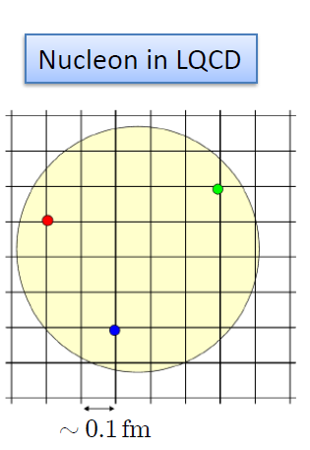
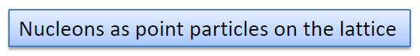
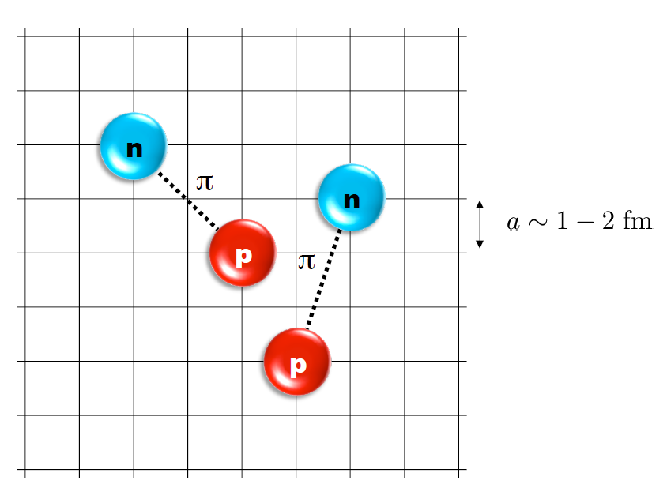
Nuclear Lattice Effective Field Theory
One of ab initio method for many fermion system
(Figures from Dean’s presentation)

Slide 9
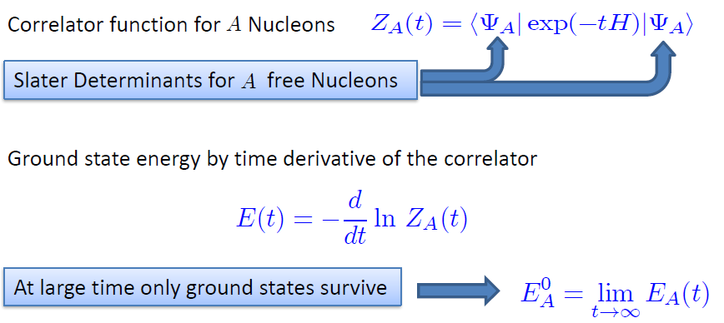
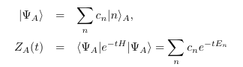
Path integral
(From Dean’s presentation)

Slide 10
Lattice Hamiltonian
We need to introduce a lattice scale in space and time:
momentum space cutoff ~ 150 MeV → lattice size a= 1.316 fm
Time cutoff ~ 1000 MeV
We need to determine coefficients of interaction for the lattice size. (regularization scale.)
Two-body interaction coefficients can be determined from phase shifts of np scattering.
Three-body interaction can be fixed from binding energy of A>=3.

Slide 11
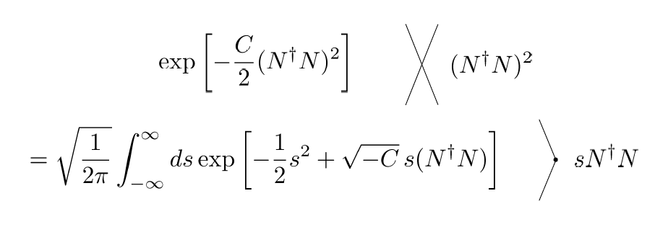
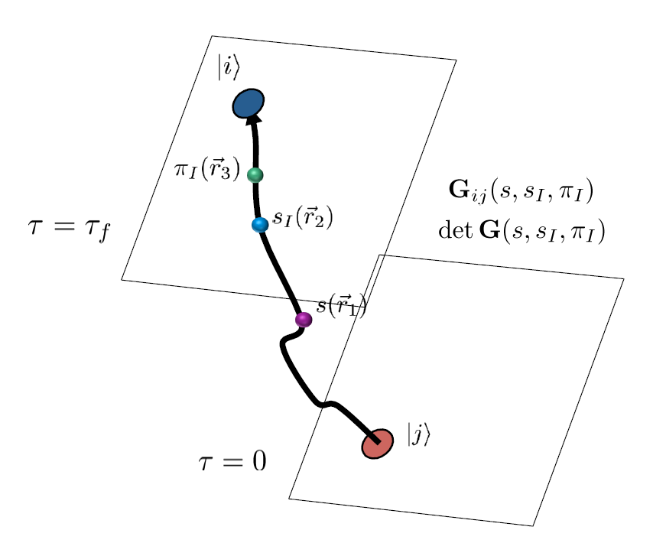
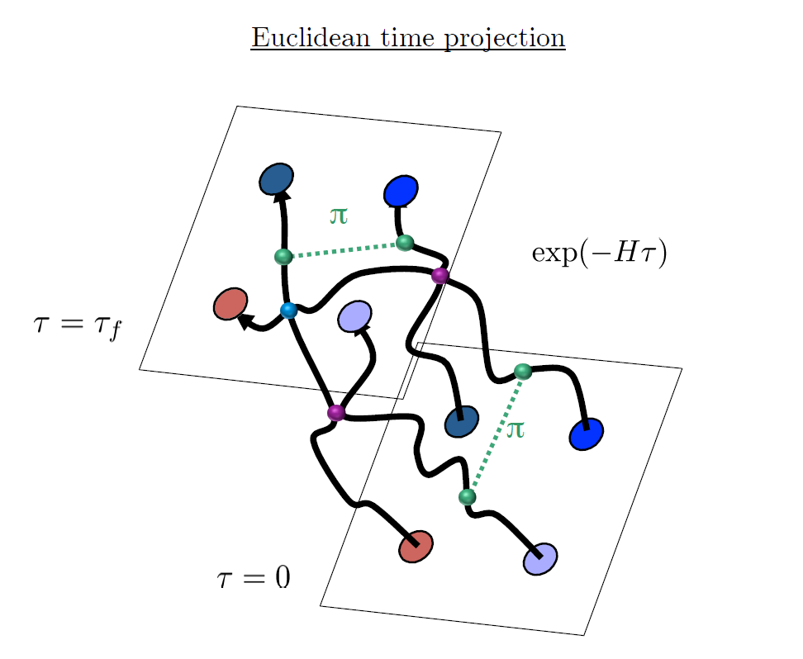
Auxiliary Field Monte Carlo
(Figure From Dean’s presentation)

Slide 12
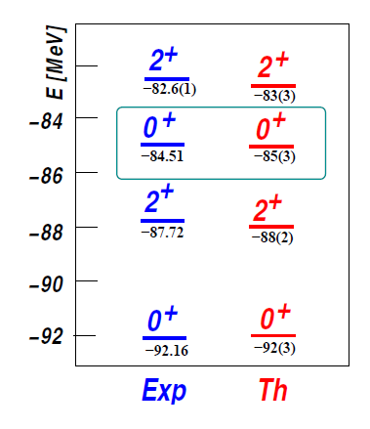
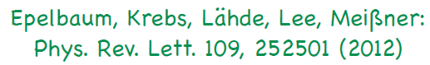
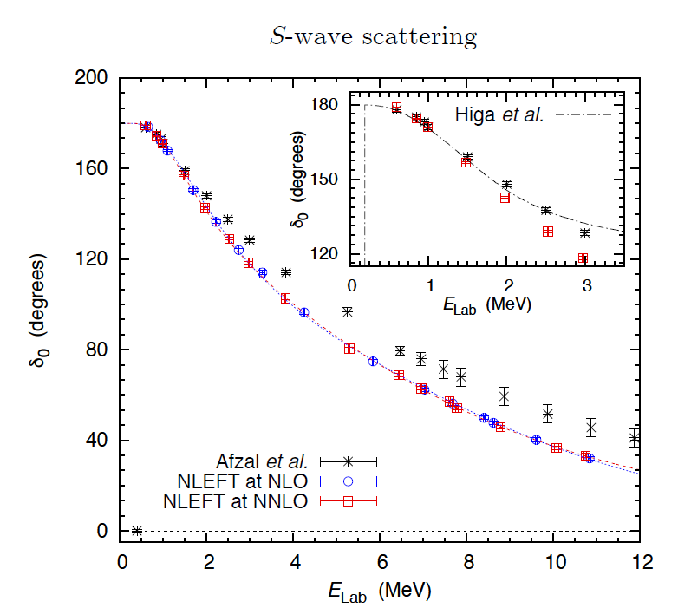
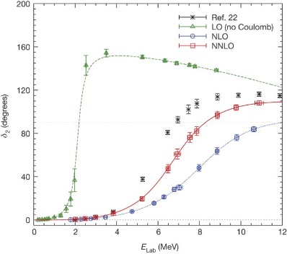
Applications of NLEFT
The first ab-initio calculation of
Hoyle state
Has been successfully applied to
Nuclear matter, Cold atom, dilute fermion system
Finite nuclei (A<=50)
First ab-initio calculation of Hoyle state
Cluster structure of ¹²C and ¹⁶O
NN scattering, N-D scattering
Alpha-alpha scattering
radiative capture, fusion
Etc.
Ab initio alpha-alpha scattering
( Nature 528, 111-114(2015))

Slide 13
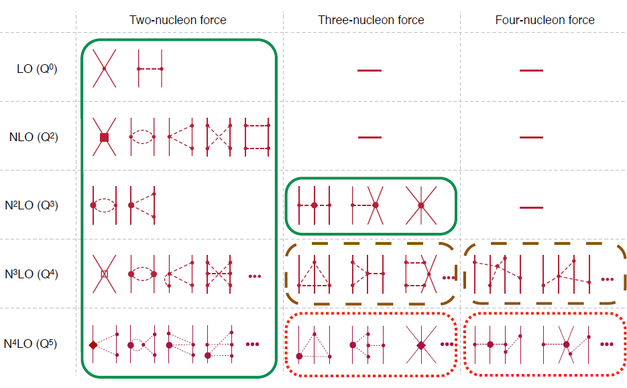
Chiral Effective Field Theory

Slide 14
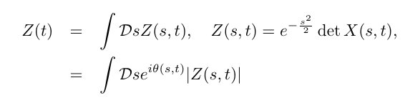
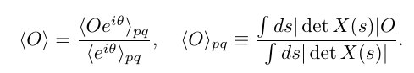
Sign problem in NLEFT
However, there is a difficulty in auxiliary MC calculation
We needs a large Euclidean time extrapolation
If the denominator’s sign oscillates rapidly
→ large uncertainty in the expectation value
→ sign problem
SU(4) symmetric interaction in isospin symmetric system
→ No sign problem

Slide 15
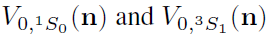
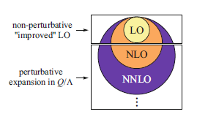
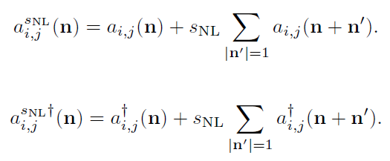
Improved action with non-locality
In practical calculation, sign problem and convergence of perturbation have to be taken care of.
To improve the non-perturbative calculation,
Local and non-local smearing of contact interaction are introduced.

Slide 16
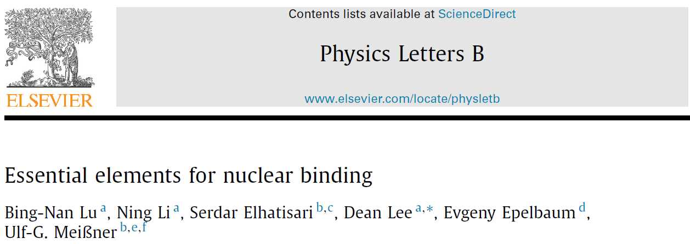
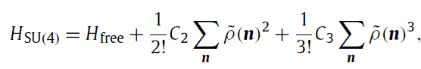
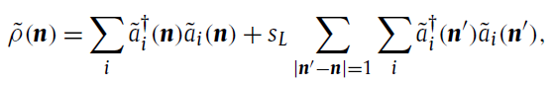
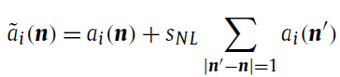
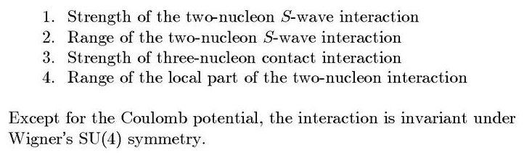
Minimal nuclear interaction
Which reproduce
Light nuclei
medium mass nuclei
neutron matter
simultaneously up to few percent error in binding energy and charge radius
Only Four parameters
No sign problem

Slide 17
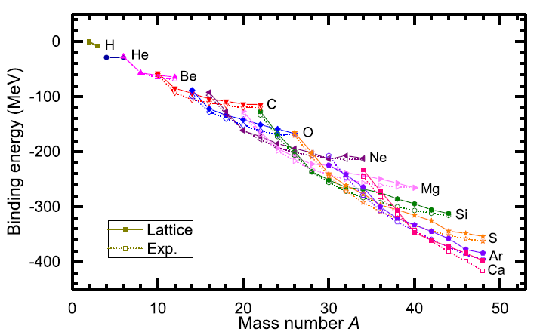
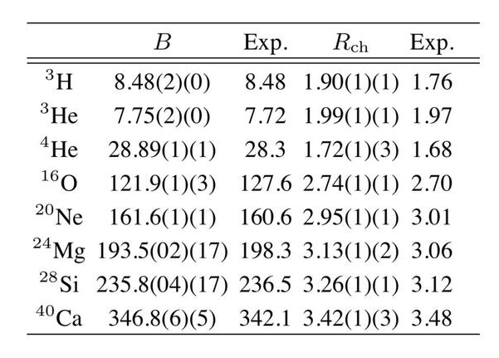
Can we improve the agreement by
Including higher order corrections?

Slide 18
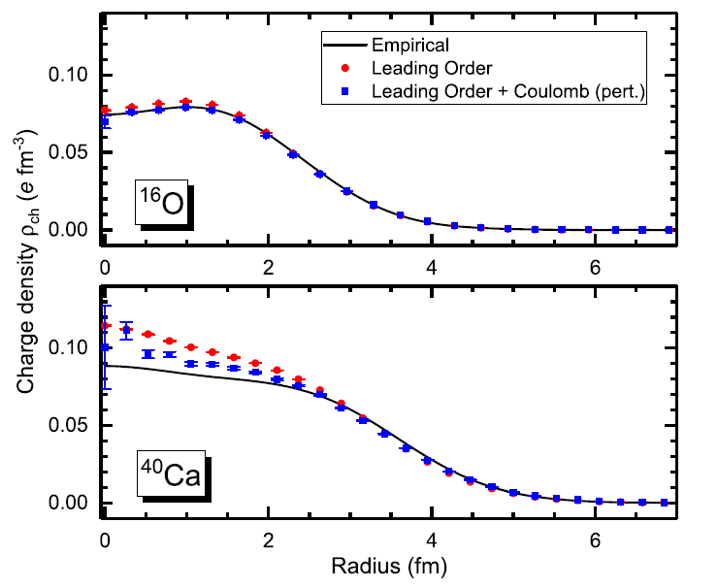
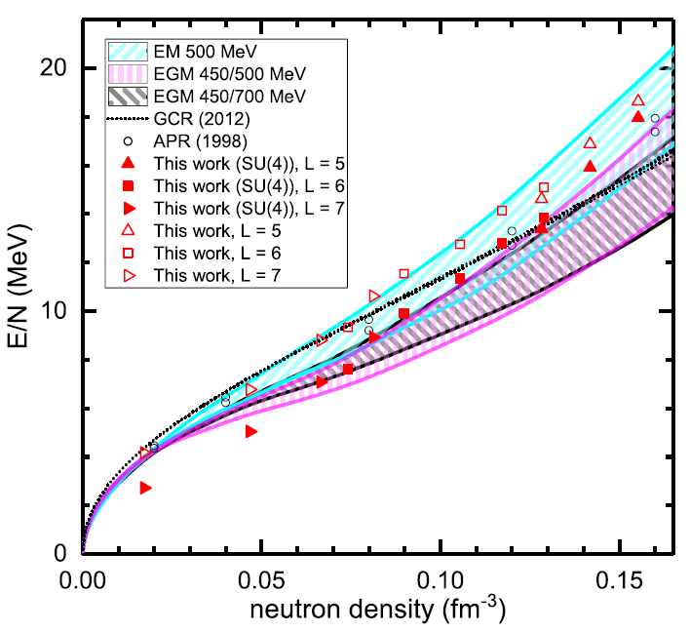
Can we improve the agreement by
Including higher order corrections?

Slide 19
Lattice chiral Hamiltonian (N3LO)
Full N3LO Hamiltonian includes
Free Hamiltonian(Kinetic term)
Short range (nonlocal smeared) contact interactions up to Q^4 order
Isospin-breaking short range interactions
One pion exchange potential
Two pion exchange potential up to Q^4 order
Coulomb interaction
Long range isospin breaking interaction( isospin dependence in OPE)
Galilean Invariance Restoration (GIR) term (because of non-local interaction.)
Three nucleon interaction

Slide 20
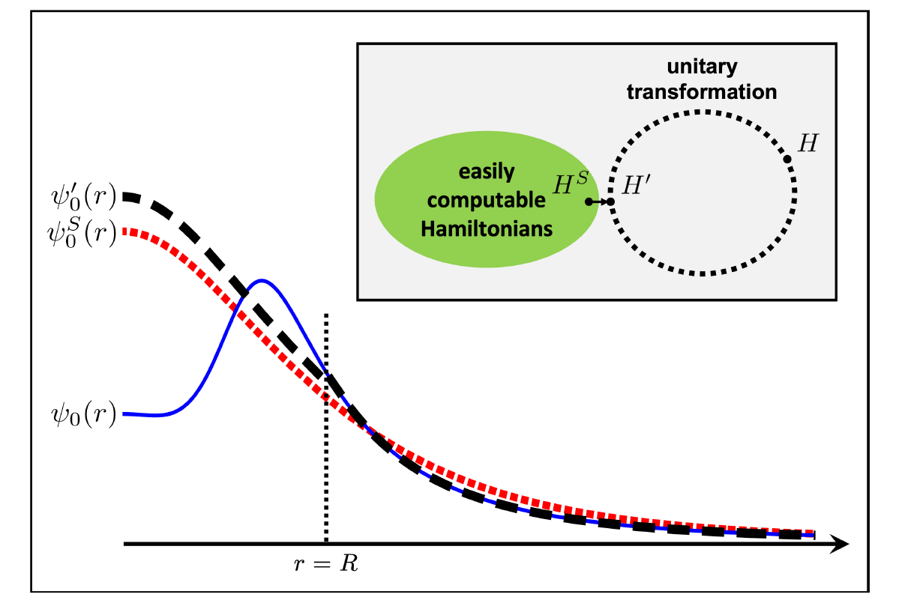
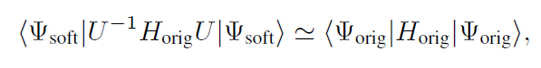
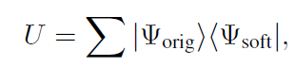
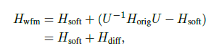
Wave function matching
H and H’ are fully equivalent to two-body observables
The goal is to make the perturbation expansion from “simple” wave function gives a good convergence
U is only active
At r < R

Slide 21
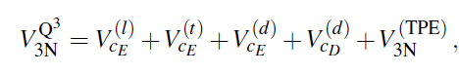
Wave function matching Hamiltonian
N3LO Hamiltonian
V_2N : short range NN interactions
W_2N: GIR restoration term for V_2N
V_2N,WFM : difference from H_s
W_2N,WFM: GIR restoration correction to V_2N,WFM
V_3N : contains short range 3N interaction parameters(to be fitted)
and two pion exchange correction to 3N

Slide 22
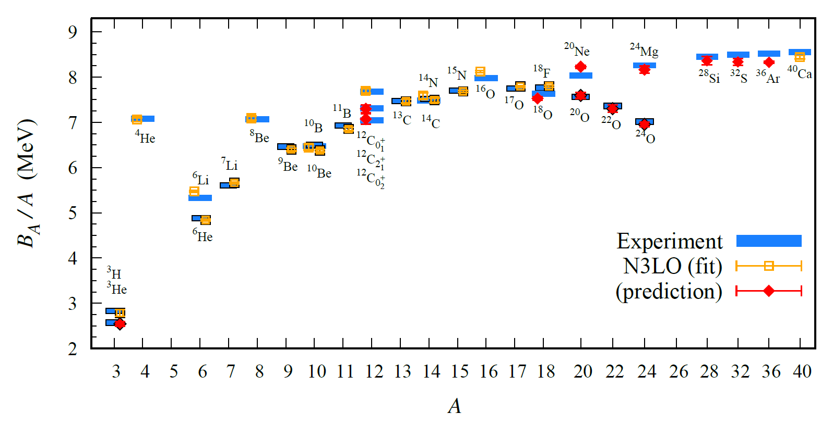
BE/A from WFM

Slide 23
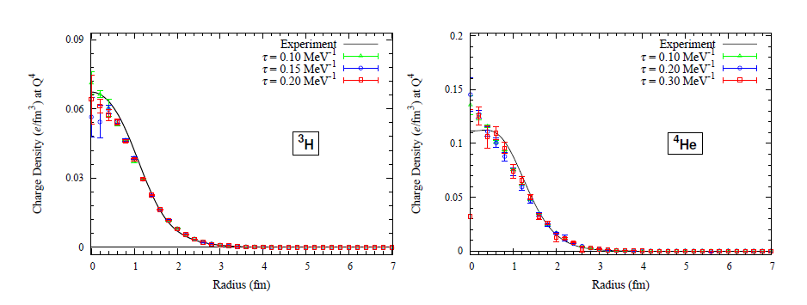
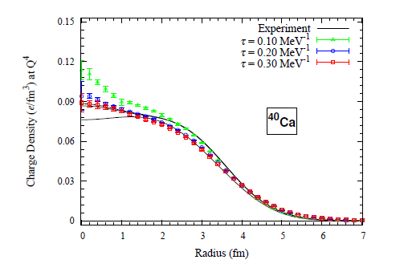
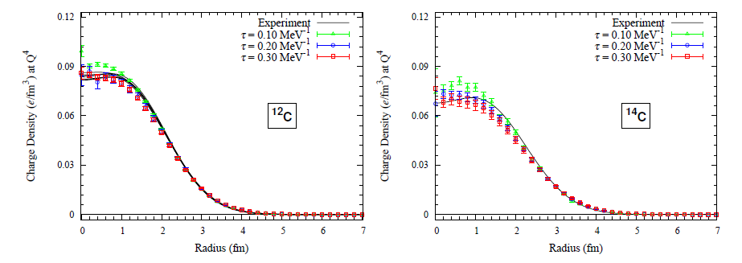
Charge density from WFM

Slide 24
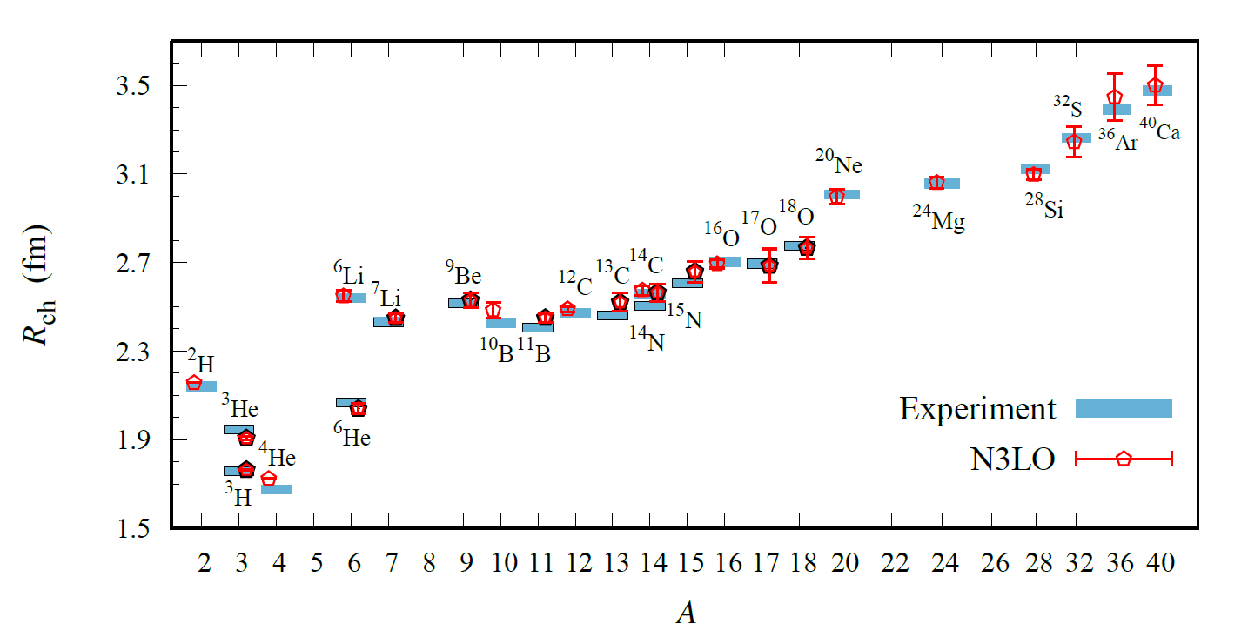
Charge Radius

Slide 25
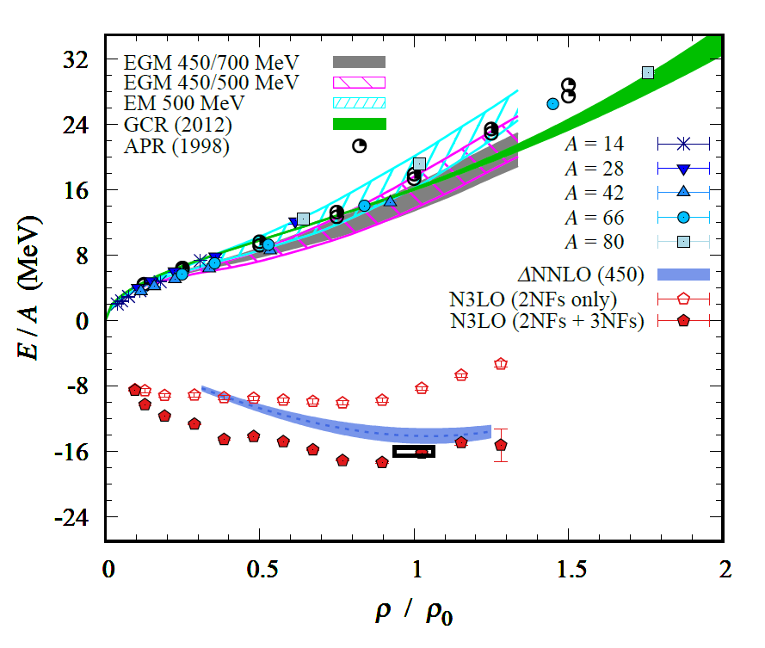
Nuclear/Neutron Matter
Neutron matter:
A=4~80
box size 6.6 ~ 13.2 fm.
Nuclear matter:
A=4 ~ 160
Box size 7.92~9.24 fm.

Slide 26
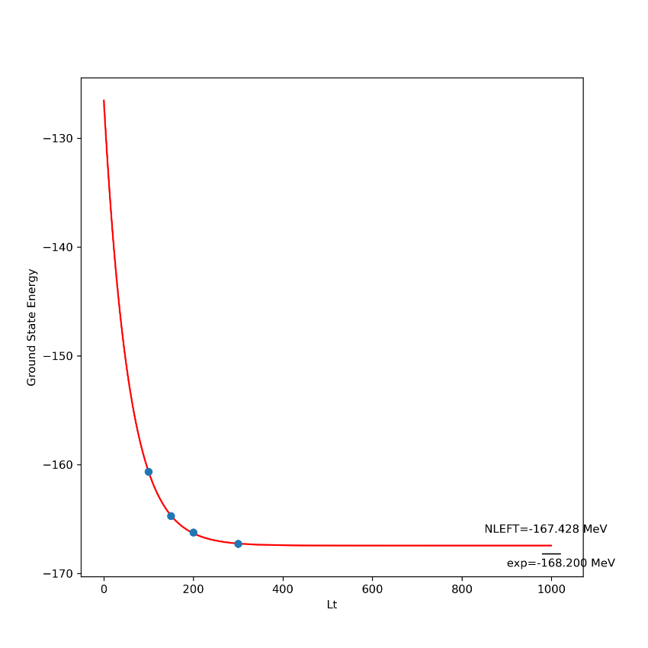
Carbon/Oxygen Isotope calculations
WFM Hamiltonian
Initial wave functions are prepared with HO wave functions
No projection operator used but prepared with correct M_z
25O

Slide 27
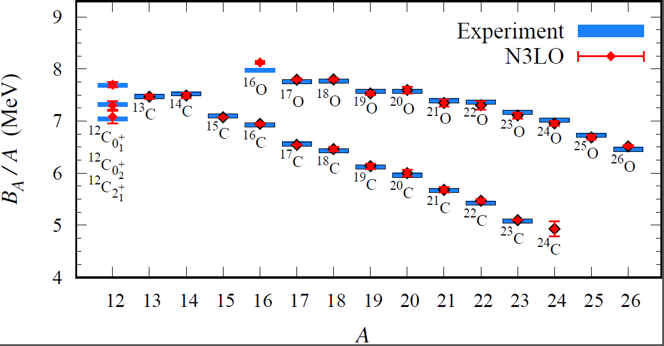
Carbon and Oxygen
Preliminary

Slide 28
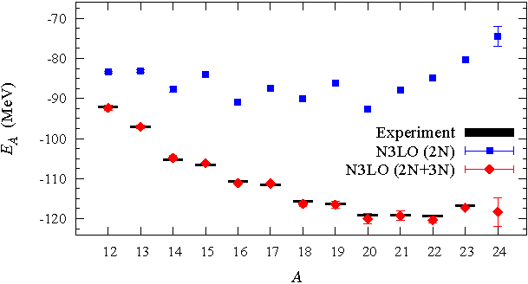
Carbon isotopes

Slide 29
Oxygen
Carbon

Slide 30
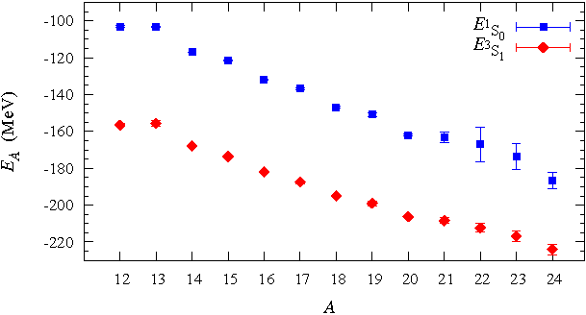
Carbon isotopes

Slide 31
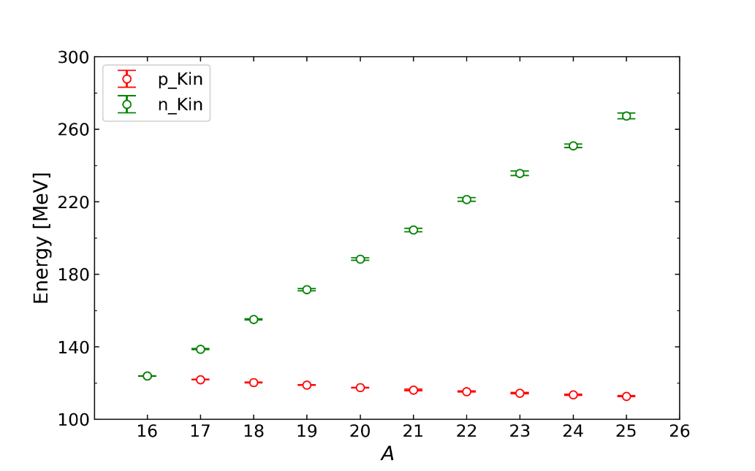
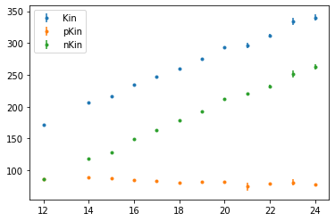
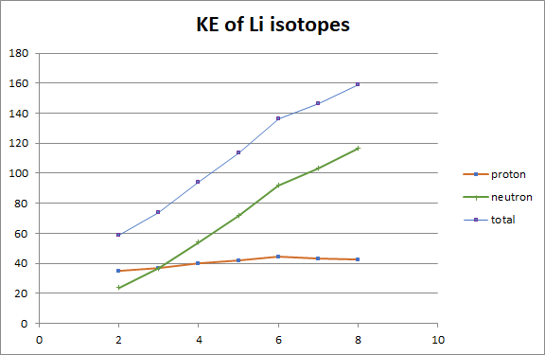
Kinetic energy
Some pattern observed for
2N, 3N contribution
1S0, 3S1 contact terms
p/n kinetic energies
However, each contributions are not physical observable and can be model dependent
NCSM results from I.-J. Shin(IRIS,IBS)

Slide 32

Charge Radius
From Yuanzhuo Ma

Slide 33
Summary
Wave function matching method seems to be promising
New method to improve the N3LO calculation of NLEFT
Preliminary study shows promising results for wide range of observables in one scheme (same interaction and many-body method)
NN scattering
Binding energy (from 3H to 40Ca)
Symmetric Nuclear matter
Neutron matter
Dripline of Oxygen isotope.
Carbon excited states
Also, Carbon isotopes, odd Oxygen isotopes, Cluster structure, excited states will be studied.

Slide 34
Others 1
(Only preliminary results)

Slide 35



G.T. transition amplitude

Slide 36



G.T. transition amplitude
1. Needs to compute two nuclei at the same time
2. For orthogonal states, Z_{12} = 0.
(Sampling channels one at a time is not suitable.)
3. How should we sample auxiliary fields for Z_{12} ?
As a starter,
WFM wave function(at LO)
only 1-body operator are used. (no 2BC contributions)
$$στ$$

Slide 37

Trial : Re-weighting method
Compute A nuclei (A wave vectors)
Select A-1 or A-2 s.p. waves to construct trial wave functions
Use the same auxiliary fields sampling for A nuclei
Reweight probability for A-1 or A-2 nuclei

Slide 38
Trial : Re-weighting method
4He within 5He
5He 4He
Lt=100 -0.25592E+02 0.12145E+00 -0.28048E+02 0.22358E+00
Lt=200 -0.26400E+02 0.21669E+00 -0.28407E+02 0.25195E+00
Lt=300 -0.26458E+02 0.18151E+00 -0.28794E+02 0.28754E+00
Lt=400 -0.26647E+02 0.15672E+00 -0.27967E+02 0.33789E+00
Fit 26.62 +/- 0.12 28.43 +/- 0.42
Exp. 27.5605 28.2956
It may be used for the Separation energy calculation
→ Correlated error estimation of separation energy

Slide 39

Trial : Re-weighting method
Preliminary calculation of 3H → 3He by using 4He sampling
|<3He| tau_{+}|3H >|~1 and |<3He|sigma_z tau_{+}|3H>|~1
Significant increase of BE error compared to independent calculations
Preliminary calculation of 6He(0+) → 6Li(1+) by using 7Li(3/2-) sampling
To fix the angular momentum, two projection operators are used.
However,
Bad convergence in binding energy of 6He, 6Li
Two Projection operators raises sign problem.

Slide 40


Trial : Mixed Sampling
Working on mixed sampling approach
Preliminary
Instead of projection operator, fix the Jz of initial wave functions
Preliminary calculation 3H->3He
Better convergence than re-weight method
<3He| GT| 3H> ~ 1.0 for all Lt
(Only LO wave function)
BE(3He)= 7.718 (exp.)
BE(3H) = 8.482 (exp.)
<3He| GT| 3H> ~ 0.958 (exp.)

Slide 41



Trial : Mixed Sampling
Preliminary
Mixed Sampling
6He(0+)→6Li(1+)
B.E. Lt dependence changed
<6Li| (GT) |6He> have Lt dependence
BE(6He) =29.27(exp.)
BE(6Li) =31.99(exp.)
<6Li| (GT) |6He> ~ 1.25 (exp)

Slide 42
Summary
G.T. Transition amplitudes
Two nuclei with different Z at the same time
→ re-weighting method was not successful
→ mixed sampling seems to work
To do :
2BC correction
higher order wave function correction

Slide 43
Others 2
(Only preliminary results)

Slide 44



Dripline for unitary Fermions
Unitary Fermion Gas :
A strongly coupled conformal system
Physically interesting multi-fermion system with simple interaction
p $\cot{δ}=0$ : Unitary limit
→largest possible scattering amplitude. Infinite scattering length.
( Realistic nuclear force is close to unitary limit.)
Universality of unitary limit of many fermion system
→ Bertsch Parameter

Slide 45





Unitary limit Hamiltonian
1S0 NN scattering phase shift is fitted for unitary limit .
→ Very large scattering length.
In cubic and BCC lattice
N=66 neutrons (33 spin up, 33 spin down)
L = 4,…, 10
Cubic lattice
BCC lattice

Slide 46
Unitary Fermions under trap
Unitary Fermion itself does not form a bound nuclei
→ Introduce an external spherical well potential
Can we find a relation between trap shape and dripline?
Separation energy have to be calculated accurately
→ Use an re-weighting method to reduce error in separation energy.
(correlated error estimation in energy difference.)
Unfortunately, realistic mean-field potential is rather expensive.
(reaching dripline in Unitary limits is difficult.)
→ limited to shallow external potential.
Try to see the dependence on parameter : y0 = m R^2 V
(Work in progress. Only preliminary results)

Slide 47


Neutrons in trap
4n

Slide 48

Separation energies
Lattice spacing 100 MeV
Spherical well
radius~ 4fm
Preliminary

Slide 49








V0=8MeV density contour
Preliminary

Slide 50


V0=8MeV density contour
Preliminary

Slide 51

Extrapolation?
Linear Fit
Needs More data
Preliminary

Slide 52
Summary
Unitary Fermions in trap
One could find driplines from two neutron separation energies
Density distribution shows leakage of neutrons
y0 dependence
However, not enough data yet for any conclusion.
→ To reduce computational cost, looking at 1d case.

